Slide 1
Attendees:
Manvi Gupta (Project Manager)
Ashu Gupta (Business Analyst)
Simranjit Singh (PCO)
Mansi Thakkar (Developer)
Kiran (Tester)
Kadidia Fofana (Client Representative)
Steering Committee Members
PMO WebApp
By: Team Paris Tech

Slide 2
Objectives & Goals
A web application to be made which monitors all the projects in an AI & robotics company, ABC TECH whose sales have increased since past 2 years and is lacking a co-ordination in its PMO department.
To monitor all the projects and to implement the gating systems as per audit standards.

Slide 3





Project Summary
Start Date- July 08, 2020
End Date- September 08, 2020
Budget Allocated- $100000 CAD
Total Planned Budget- $96711 CAD
Time Allocated & Planned- 10 weeks

Slide 4





Project Status History
Timeline
Achievements
Budget
Risk & issues
Next step

Slide 5
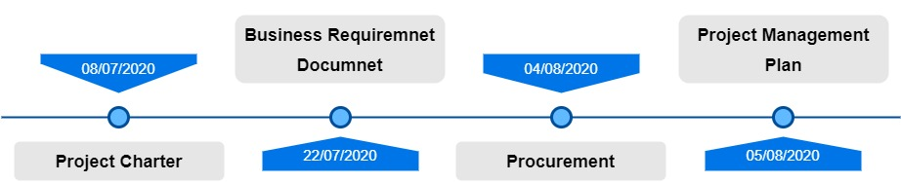
Achievements

Slide 6
Budget
Budget at completion: $1000000/-
Planned Budget: $ 47860/-
Actual Cost: $ 44340/-
Earned Value: $ 42000/-
Variance: $ -2340/-

Slide 7
Risks and issues
Risk:
Due to 1-week lagging, there can be delay in accomplishment of goals in certain phases.
Issue:
Improper communication.
No proper authorization for JIRA software.

Slide 8
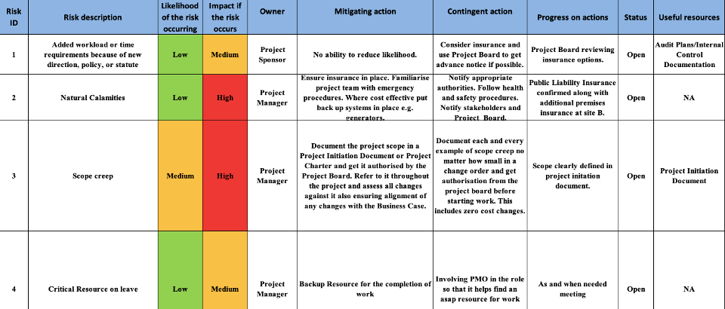
Risk Sheet

Slide 9
Ongoing Steps
DESIGN PHASE- Software design document (Approval from the client)
DEVELOPMENT- Coding
TESTING- Unit Testing

Slide 10
Upcoming Steps
Development- DB development, Cloud & VPN hosting
Testing- Integration, QA, UAT testing
DEPLOYMENT- Post Project Evaluation, CSS
TRAINING- Admin/Employee Training
GO LIVE

Slide 11
Important Milestones
Milestones | Date:
Business Requirement Document | 22/07/2020
PM Plan | 29/07/2020
Final Design Approval | 26/08/2020
Testing Approval | 01/09/2020
Final Documentation | 04/09/2020
Go Live | 08/09/2020

Slide 12
Thank you

